Slide 1

DSM2 Installation
Kevin Kao
Delta Modeling Section
California Department of Water Resources

Slide 2
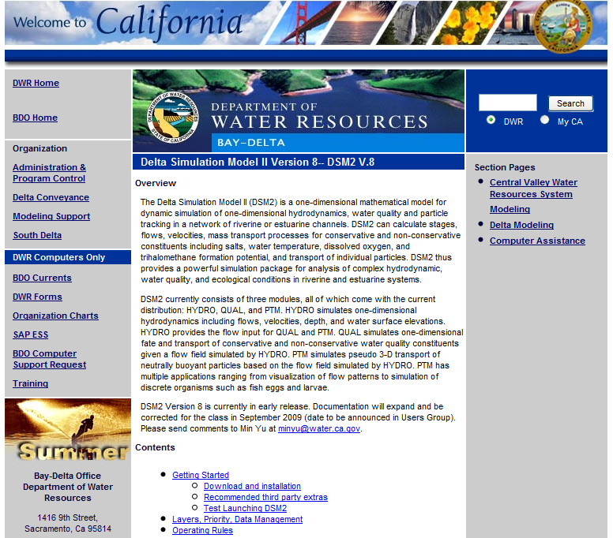
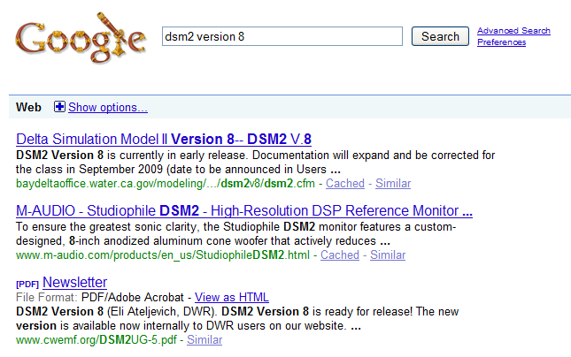
DSM2 Website
http://baydeltaoffice.water.ca.gov/modeling/deltamodeling/models/dsm2v8/dsm2.cfm
Google “dsm2 version 8”

Slide 3
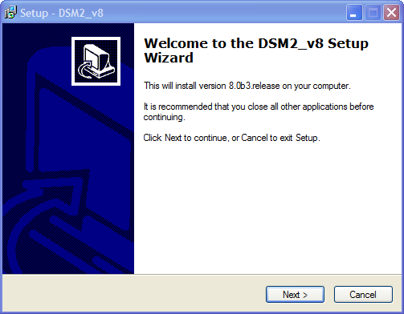
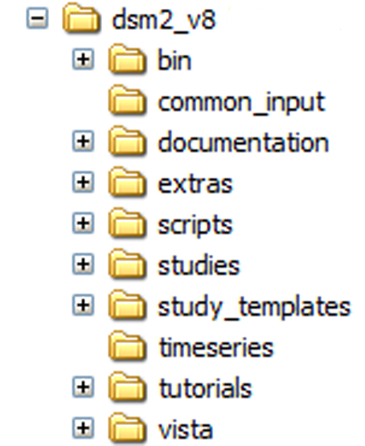
Install DSM2
Notes:
The directory structure reflects how we would like to manage the distribution and data
Read-only : common_input, study_templates
User area: studies
Documentation – you can go directly to shortcut or you launch from the start menu
Grid map – is also in the documentation folder

Slide 4
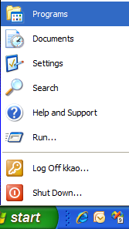

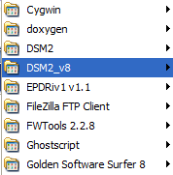
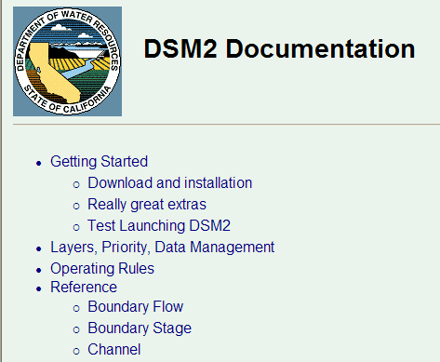
DSM2 Documentation

Slide 5
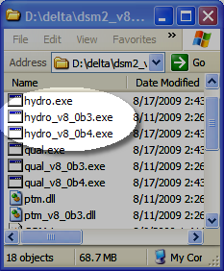
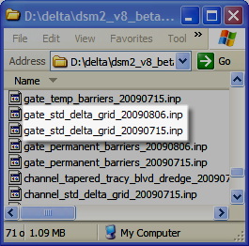
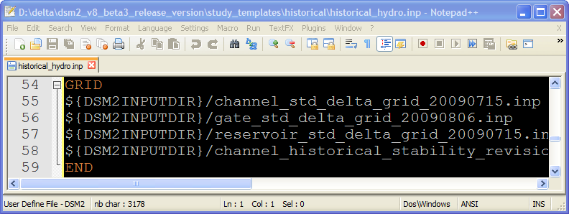
DSM2 Versioning
Notes:
Eli is going to talk about archiving and multiple installation strategies later and this version stuff is going to come up again

Slide 6
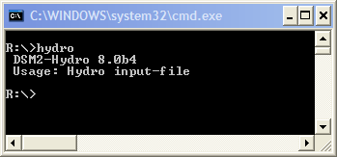
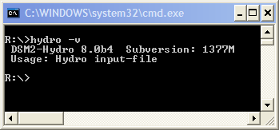
Check DSM2 version

Slide 7
3rd Party Software
Notes:
We are going to use introduce other tools in class for viewing DSS and HDF5 files. Instructions for getting these should be on the web page

Slide 8
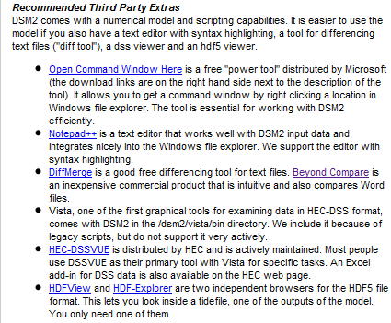
3rd Party Software
http://baydeltaoffice.water.ca.gov/modeling/deltamodeling/models/dsm2v8/dsm2.cfm

Slide 9
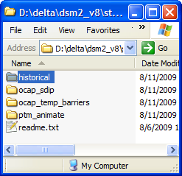
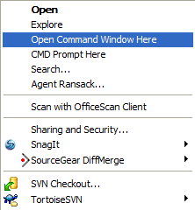
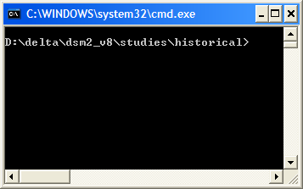
Open Command Window Here

Slide 10
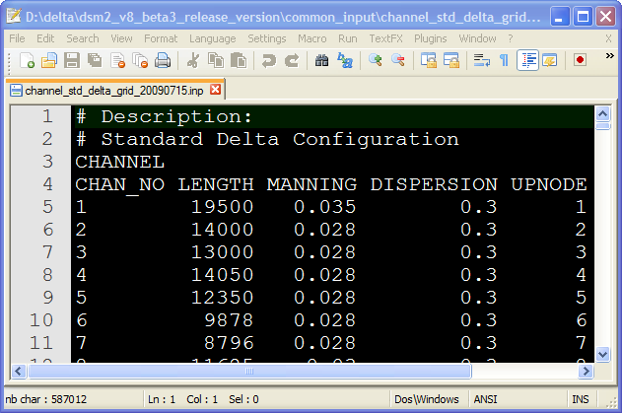
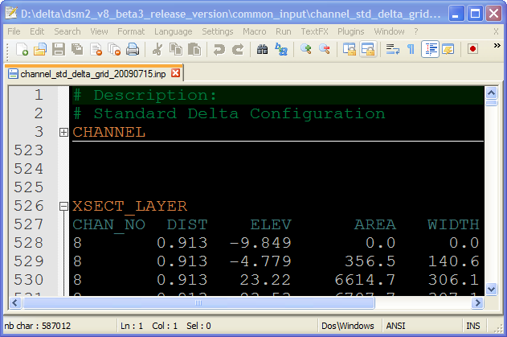
Notepad++ syntax highlighting
Notes:
Instructions for syntax highlighting configurations are in Readme.txt in the installed folder \dsm2_v8\extras\notepad++

Slide 11
FAQ

Slide 12
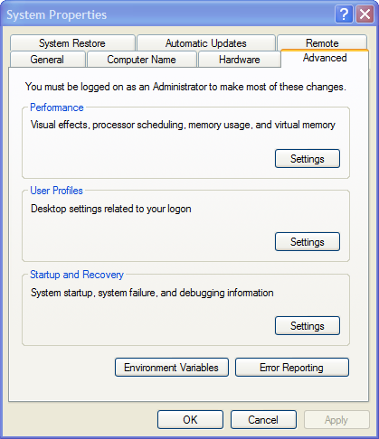
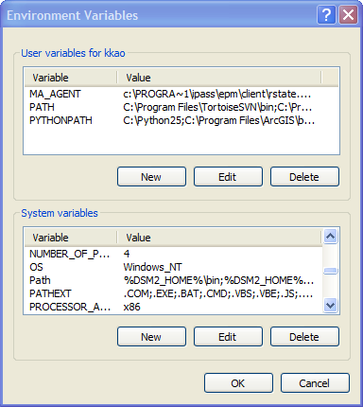
Question: Can I just move my installation?
Yes, but you will have to change some Environment variables.
%DSM2_HOME%\bin
%DSM2_HOME%\vista\bin
%VISTA_HOME%
Notes:
Eli will cover this in detail.

Slide 13
Question: What happened if Installing over previous install?
Hydro.exe & Qual.exe overwritten
Version control exe retained
Augmented. Nothing changed
User’s studies unchanged
Replaced
Notes:
Eli will cover this in detail.
Hydro.exe and Qual.exe overwritten
/common_input augmented, nothing will be changed
/scripts replaced
/study_templates replaced
/study unchanged

Slide 14
Question: What happened if Installing over previous install?
Notes:
New input files are added but old files are not changed. Eli is going to talk about archiving and multiple installation strategies later and this version stuff is going to come up again

Slide 15
DSM2 Website
http://baydeltaoffice.water.ca.gov/modeling/deltamodeling/models/dsm2v8/dsm2.cfm
Google “dsm2 version 8”

Slide 17
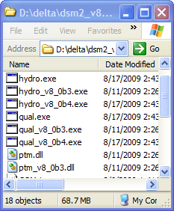

Slide 18
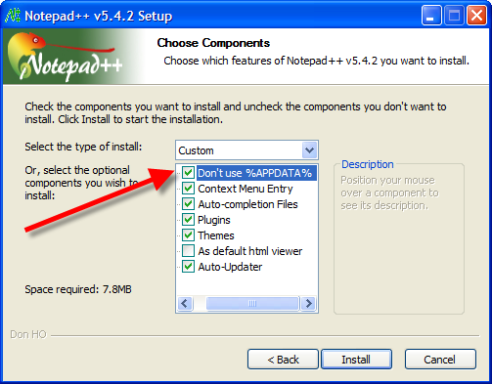
Install Notepad++
Install Notepad++ with the option “Don’t use %APPDATA%”.
Notes:
Download Notepad++ from here:
http://superb-west.dl.sourceforge.net/sourceforge/notepad-plus/npp.5.4.2.Installer.exe
Install Notepad++ with the option “Don’t use %APPDATA%”.
Copy the file “userDefineLang.xml” under “your dsm2_8 directory\extras\notepad++ “(e.g., “D:\delta\dsm2\extras\notepad++ “ ) to your Notepad++ installation folder (e.g., “C:\Program Files\Notepad++”).
When working with tables you will want the columns to line up, so it is useful if all the characters are the same width – this is known as monospace. Only a few fonts are monospace, including Courier New and Courier. Due to a quirk of notepad++, if you want monospace, you need to set the global default. The way to do this is to go to Settings->Style Configurator and edit Global Styles font to be Courier New.

Slide 19

DSM2 Documentation
DSM2 Cool Tip
⇨ All Programs ⇨ DSM2v8 ⇨ DSM2_documentation

